Slide 1
Quantum Gates and Quantum Circuits
Dr. Thyagaraju G S
Professor and HoD, Department of CSE,
SDM Institute Of Technology, Ujire-574240

Slide 2
Topics :
Quantum Gates
Quantum Circuits

Slide 3
1. Quantum Gates
Pauli Gates (X, Y, Z)
Hadamard Gate (H)
Phase Gates (S, T)
Controlled Gates(CX,XZ)
Swap Gate
Toffoli Gate (CCNOT)
Fredkin Gate (CSWAP)
Identity Gate (I)
Rotation Gates (Rx, Ry, Rz)

Slide 4
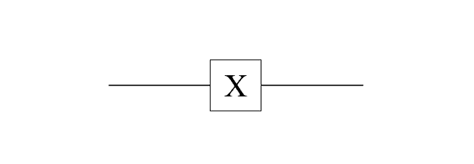
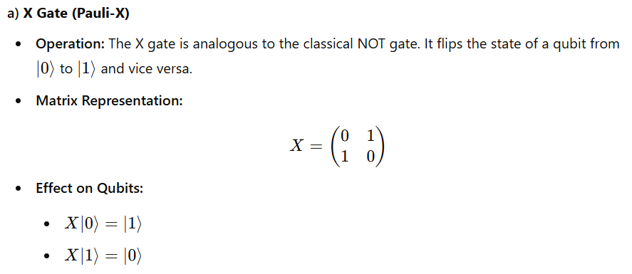
1.1.1 Pauli X Gate

Slide 5
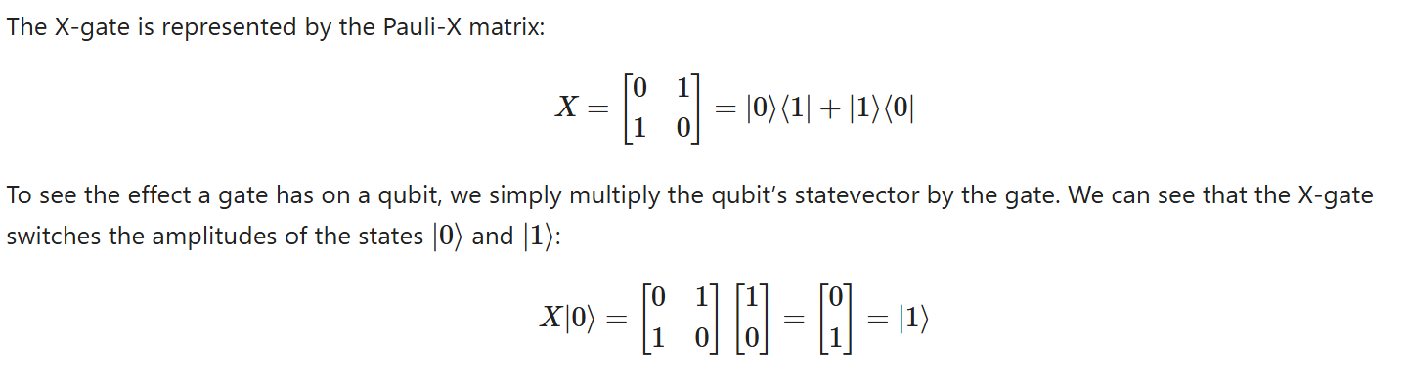
Pauli X Gate

Slide 6
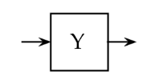
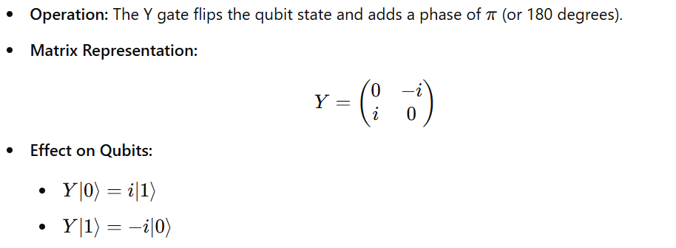
1.1.2 Y Gate (Pauli-Y)

Slide 7
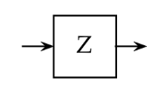
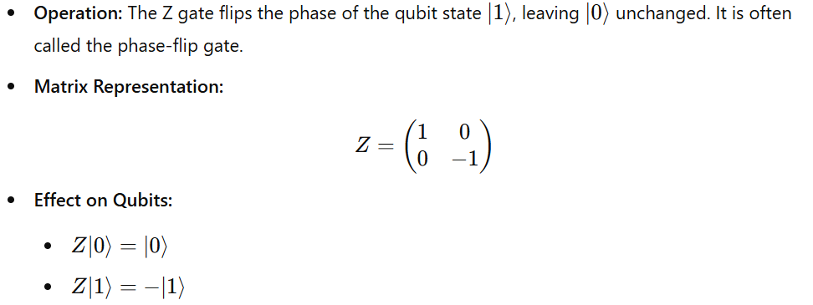
1.1.3 Z Gate (Pauli-Z)

Slide 8
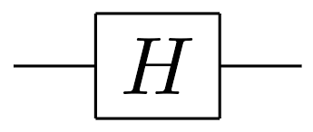
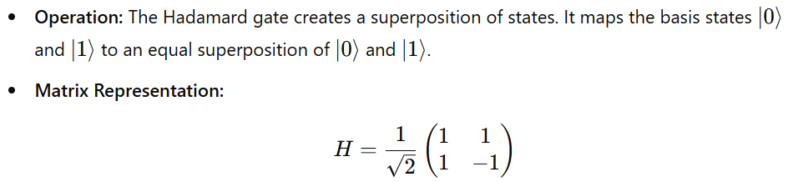
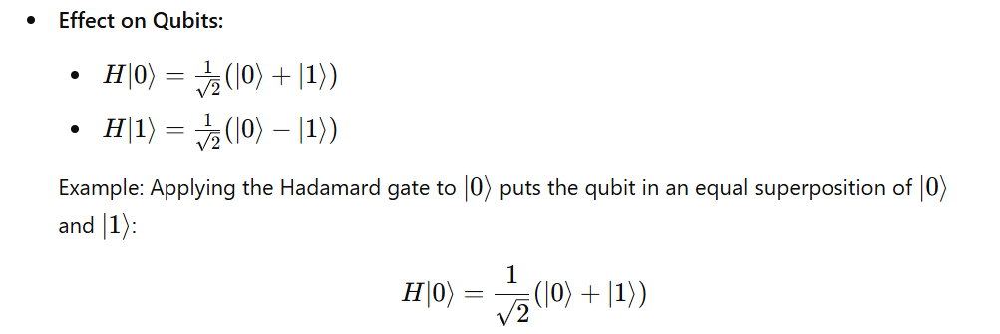
1.2 Hadamard Gate (H)

Slide 9
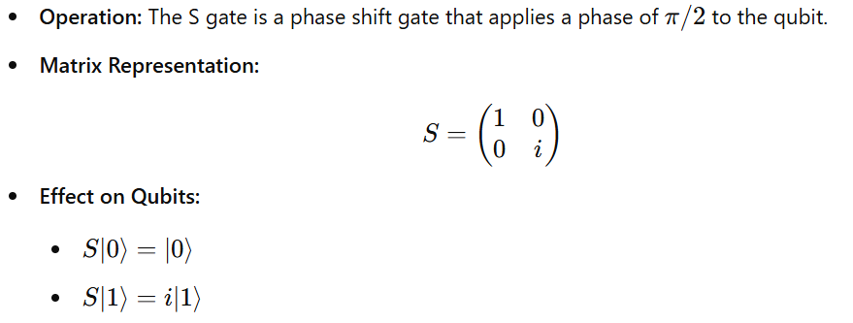
1.3.1 S Gate (Phase Gate)

Slide 10
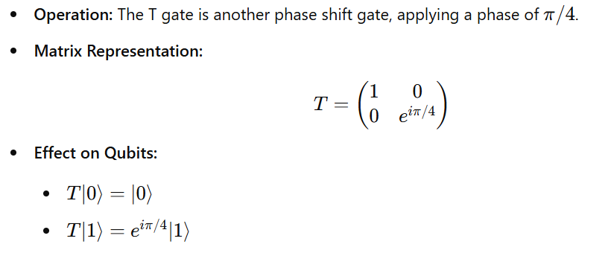
1.3.2 T Gate (Phase Gate)

Slide 11
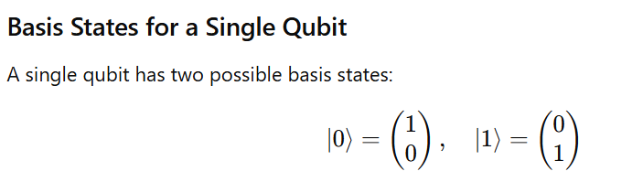
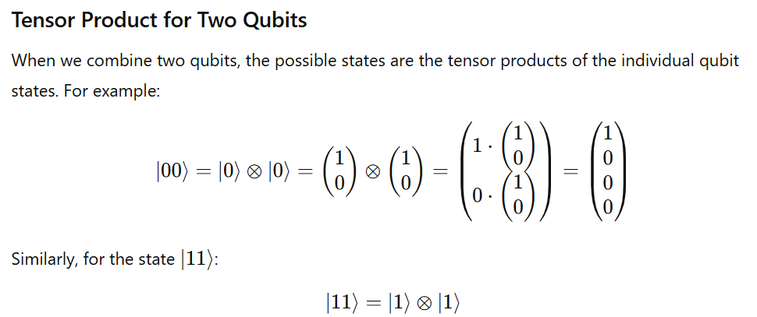
Note

Slide 12
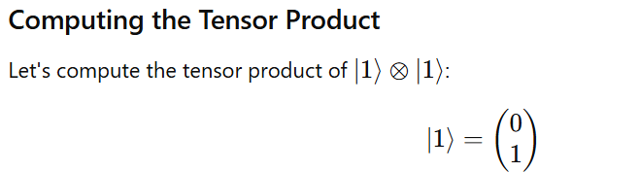
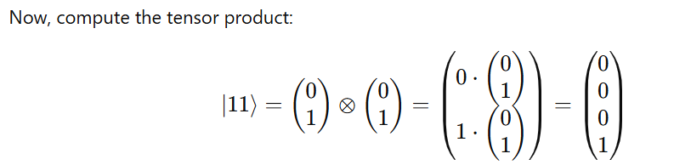
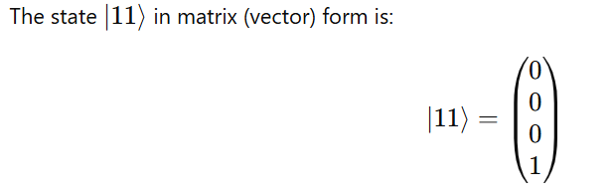

Slide 13
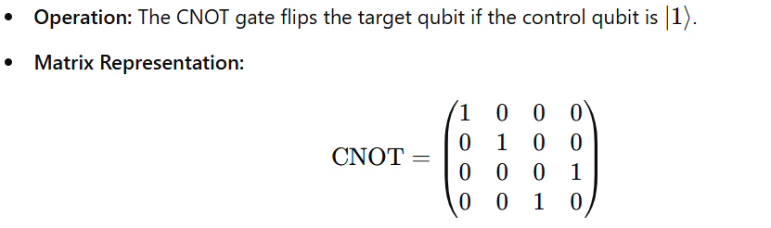
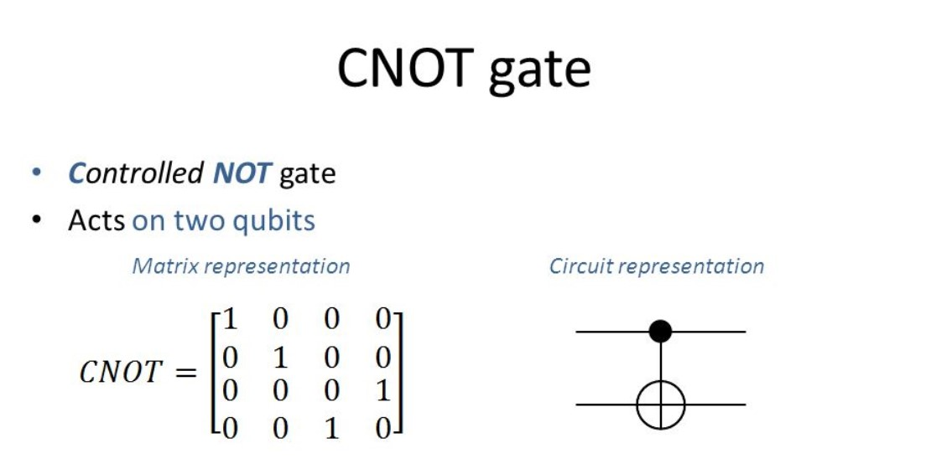
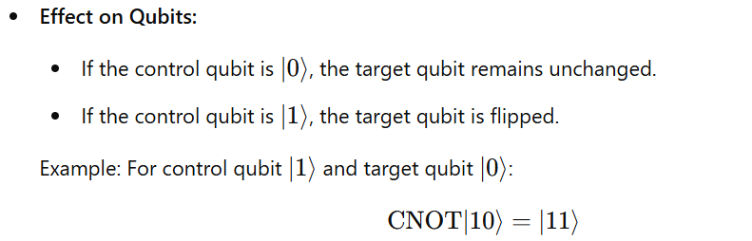
1.4.1 CNOT Gate (Controlled-X)
The Controlled-NOT (CNOT) gate, also known as the Controlled-X gate, is a two-qubit gate that flips the state of the target qubit if the control qubit is in the state ∣1>

Slide 14
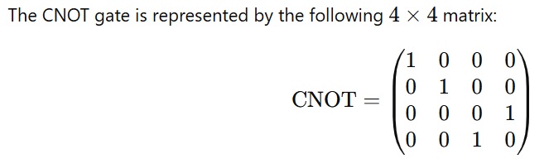
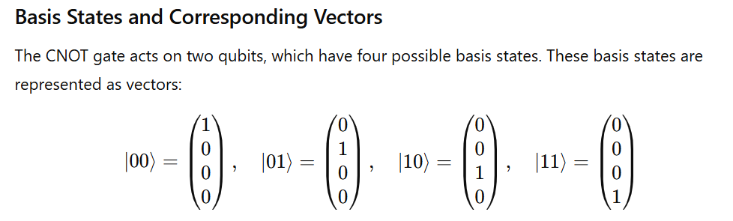
CNOT Gate Matrix Representation

Slide 15
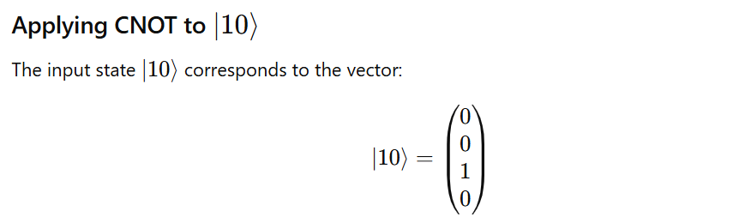
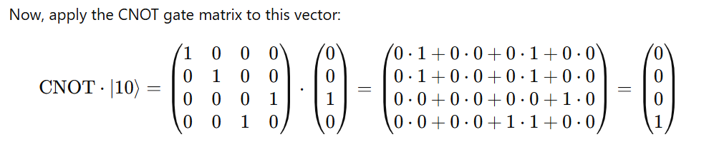


Slide 16
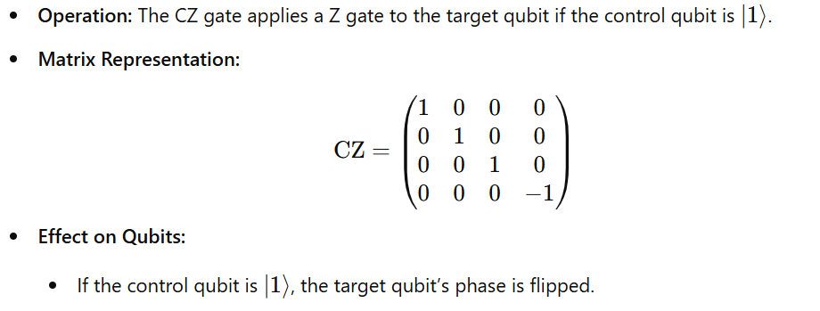
1.4.2 Controlled-Z Gate (CZ)
The Controlled-Z (CZ) gate is a two-qubit quantum gate that applies a Z gate (also known as a phase-flip gate) to the second qubit, but only if the first qubit (the control qubit) is in the state ∣1⟩|1\rangle∣1⟩. Otherwise, it leaves both qubits unchanged.

Slide 17
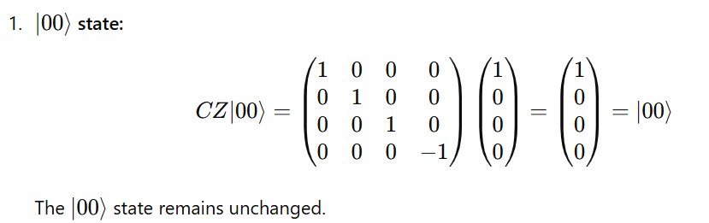
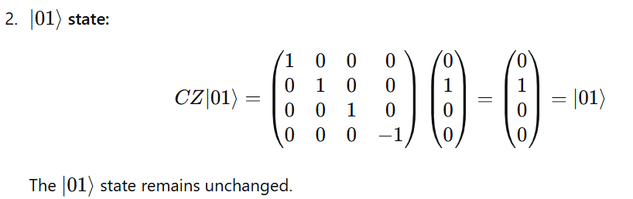
Applying the CZ Gate to Basis States

Slide 18
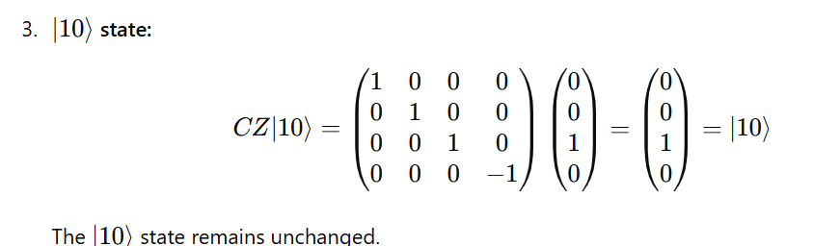
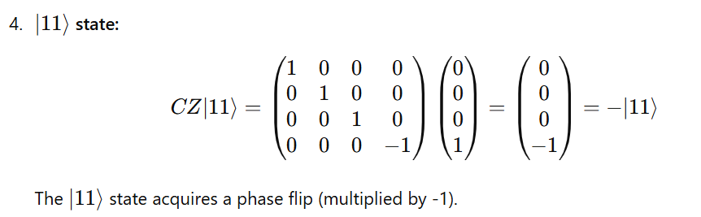
Applying the CZ Gate to Basis States

Slide 19
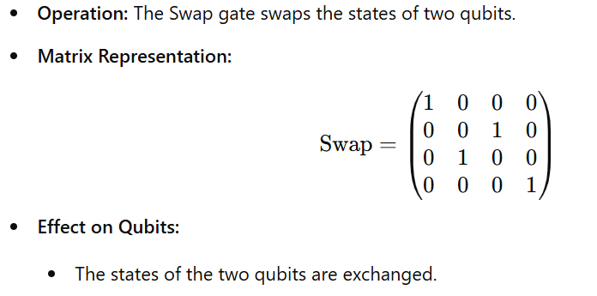
1.5 Swap Gate

Slide 20
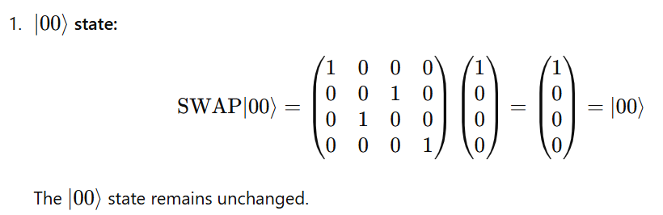
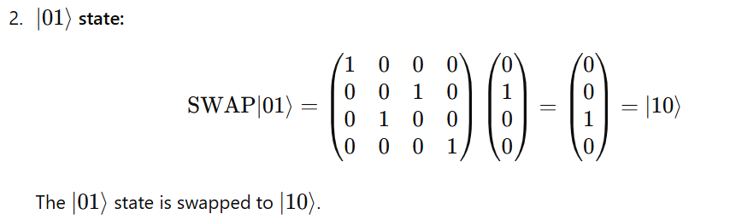
Applying the Swap Gate to Basis States

Slide 21
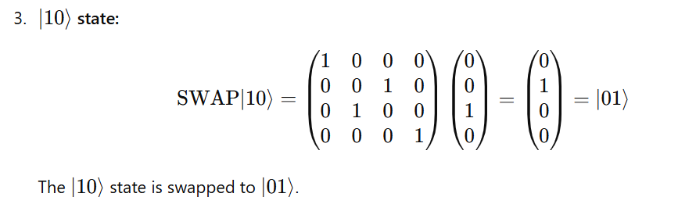
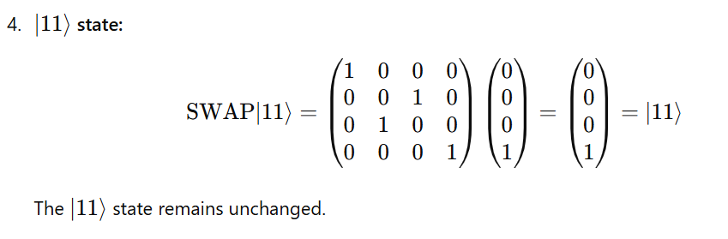

Slide 22
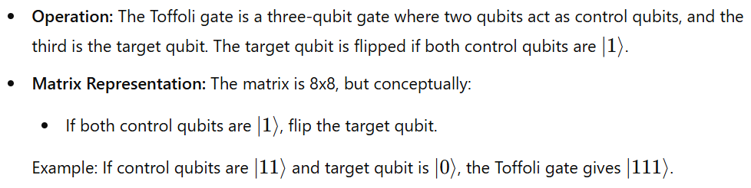
1.6 Toffoli Gate (CCNOT)

Slide 23

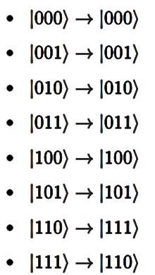
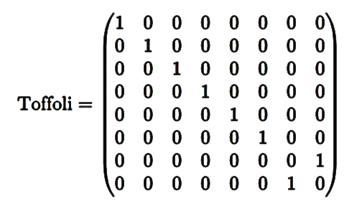
The Toffoli gate performs the following operation on the computational basis states:
The target qubit (third qubit) is flipped only when both control qubits (first and second qubits) are ∣1⟩.

Slide 24
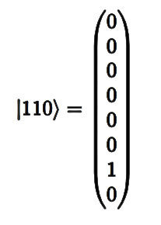
State Vector ∣110⟩:
The state ∣110⟩ corresponds to the following column vector (indexing from 0):

Slide 25
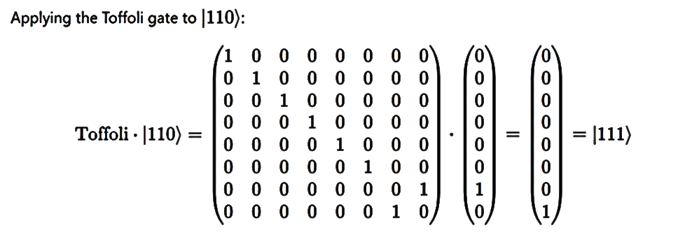

Slide 26
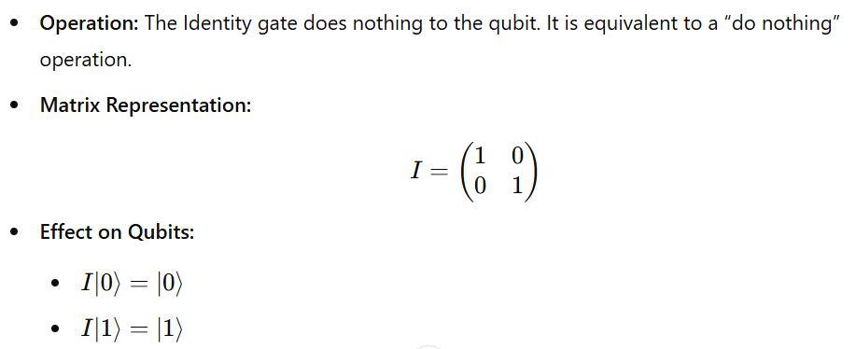
1.7 Identity Gate (I)

Slide 27
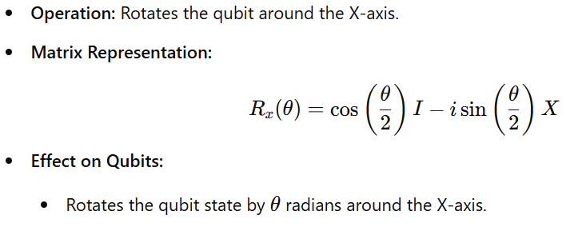
1.8.1 Rx Gate

Slide 28
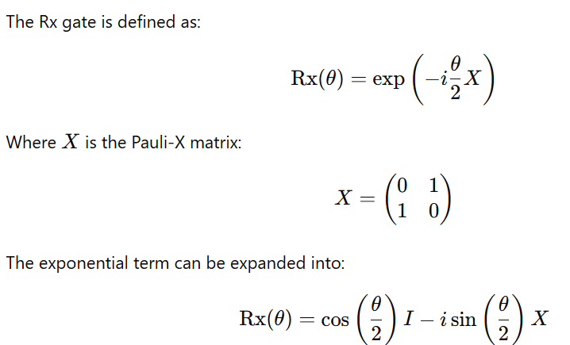
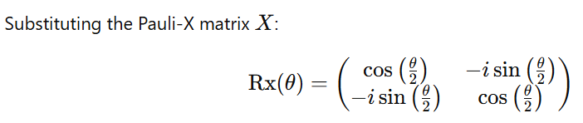
The Rx gate is a single-qubit rotation gate that rotates the state of a qubit around the X-axis of the Bloch sphere

Slide 29
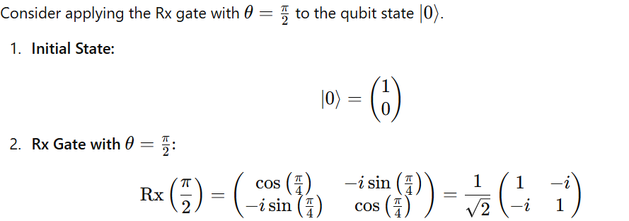
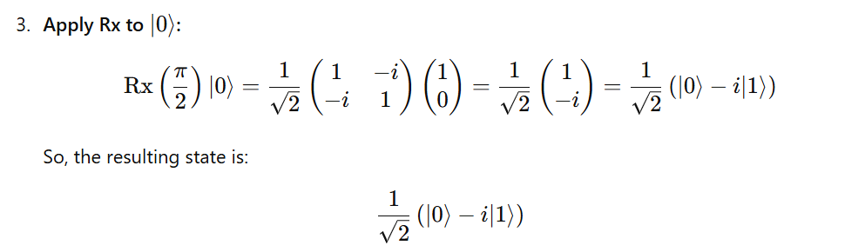
Example 1: Rx Gate on ∣0⟩

Slide 30
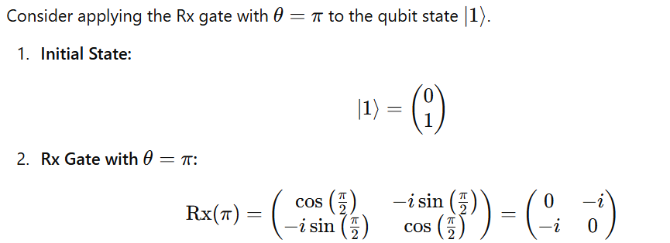
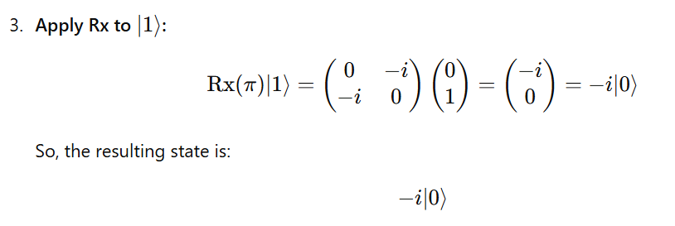
Example 2: Rx Gate on ∣1⟩

Slide 31
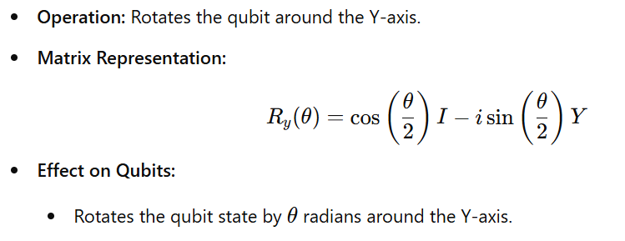
1.8.2 Ry Gate

Slide 32
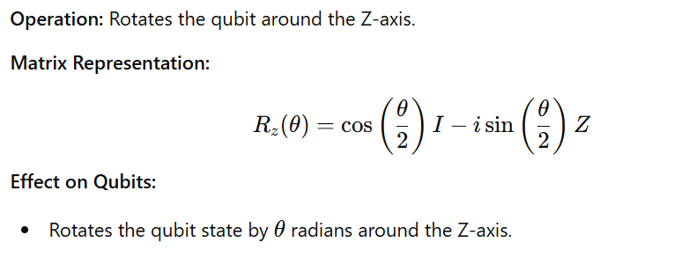
1.8.3 Rz Gate

Slide 33
2.0 Quantum Circuit
Quantum circuit is
Sequences of quantum gates applied to qubits,.
Model for quantum computation, where quantum information is processed through a series of quantum gates to manipulate qubit states and generate outputs.

Slide 34
Basic Structure of a Quantum Circuit
A quantum circuit typically consists of:
Qubits: The basic unit of quantum information, analogous to bits in classical computing. Qubits can exist in superposition states.
Quantum Gates: Operations that change the state of qubits.
Single-qubit gates (e.g., Hadamard, Pauli-X, Y, Z)
Multi-qubit gates (e.g., CNOT, SWAP)
Measurement: The final step in a quantum circuit, where the qubits are measured to produce a classical output. The process of observing qubit states, collapsing superpositions.
Circuit diagram: A visual representation of qubit operations over time.
Initialization: Setting qubits to known starting states.
Quantum register: A collection of qubits used in the circuit.
Classical register: Stores measurement results for further processing.

Slide 35
Types
Quantum circuits can be categorized based on their functionality and the types of operations they perform. Here are some common types of quantum circuits:

Slide 36
1. Basic Quantum Circuits
These circuits perform simple quantum operations such as initializing qubits, applying single-qubit gates, and measuring the output.
Example: Basic Quantum Circuit
Circuit: Apply a Hadamard gate to a single qubit, then measure the result.
Operation: This circuit creates a superposition state

Slide 37
2. Entanglement Circuits
These circuits involve creating entangled states between two or more qubits, where the state of one qubit is dependent on the state of another. The most common example is the Bell state.
Example: Entanglement Circuit
Circuit: Apply a Hadamard gate to the first qubit and a CNOT gate to entangle it with the second qubit.
Operation: This circuit creates an entangled Bell state.

Slide 38
3. Quantum Fourier Transform (QFT) Circuits
QFT circuits perform the quantum equivalent of the discrete Fourier transform on a set of qubits. QFT is essential in quantum algorithms like Shor's algorithm for factoring large numbers.
Example: QFT Circuit
Circuit: Perform a QFT on 3 qubits.
Operation: This circuit maps the input qubits to a superposition state that represents their Fourier coefficients.

Slide 39
4. Grover's Search Circuit
Grover's algorithm is a quantum search algorithm that provides a quadratic speedup over classical search algorithms. The Grover circuit is designed to find a specific item from an unsorted database.
Example: Grover's Circuit
Circuit: Implement Grover's search algorithm to find a specific state.
Operation: This circuit amplifies the amplitude of the desired state to increase its probability of being measured.

Slide 40

Quantum Circuits
In the quantum circuit model, wires represent qubits and gates represent operations acting on these qubits.
In this circuit, we have a single qubit named X, which is represented by the horizontal line, and a sequence of gates representing unitary operations on this qubit.

Slide 41
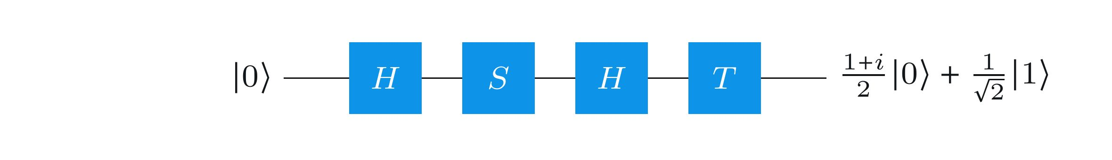
Quantum Circuits
In the quantum circuit model, wires represent qubits and gates represent operations acting on these qubits.

Slide 42

Another example of a quantum circuit, this time with two qubits
As always, the gate labeled H refers to a Hadamard operation, while the second gate is a two-qubit gate: it's the controlled-NOT operation, where the solid circle represents the control qubit and the circle resembling the symbol ⊕ denotes the target qubit.

Slide 43
Another example of a quantum circuit, this time with two qubits
Above circuit describes an operation on a pair of qubits (X,Y) — and if the input to the circuit is a quantum state ∣ψ⟩∣ϕ⟩, then this means that the lower qubit X starts in the state ∣ψ⟩ and the upper qubit Y starts in the state ∣ϕ⟩.

Slide 44

The first operation is a Hadamard operation on Y:
When applying a gate to a single qubit like this, nothing happens to the other qubits — and nothing happening is equivalent to the identity operation being performed.

Slide 45


The first operation is a Hadamard operation on Y:
In our circuit there is just one other qubit, X, so the dotted rectangle in the figure above represents this operation:
Note that the identity matrix is on the left of the tensor product and H is on the right, which is consistent with Qiskit's ordering convention.

Slide 46

The second operation is the controlled-NOT operation, where Y is the control and X is the target:

Slide 47

The controlled-NOT gate's action on standard basis states is as follows:

Slide 48


Given that we order the qubits as (X,Y), the matrix representation of the controlled-NOT gate is this:
The unitary operation of the entire circuit, which we'll call U,U, is the composition of the operations:

Slide 49

In particular, recalling our notation for the Bell states,

Slide 50

We get

Slide 51

In general, quantum circuits can contain any number of qubit wires. We may also include classical bit wires, which are indicated by double lines like in this example:

Slide 52
Sometimes it is convenient to depict a measurement as a gate that takes a qubit as input and outputs a classical bit (as opposed to outputting the qubit in its post-measurement state and writing the result to a separate classical bit). This means the measured qubit has been discarded and can safely be ignored thereafter.

Slide 53

For example, the following circuit diagram represents the same process as the one in the previous diagram, but where we ignore X and Y after measuring them:

Slide 54

Single-qubit gates are generally shown as squares with a letter indicating which operation it is, like this:

Slide 55

Not gates (also known as X gates) are also sometimes denoted by a circle around a plus sign:

Slide 56

Swap gates are denoted as follows:

Slide 57

Controlled-gates, meaning gates that describe controlled-unitary operations, are denoted by a filled-in circle (indicating the control) connected by a vertical line to whatever operation is being controlled. For instance, controlled-NOT gates, controlled-controlled-NOT (or Toffoli) gates, and controlled-swap (Fredkin) gates are denoted like this:

Slide 58

Arbitrary unitary operations on multiple qubits may be viewed as gates. They are depicted by rectangles labeled by the name of the unitary operation. For instance, here is a depiction of an (unspecified) unitary operation UU as a gate, along with a controlled version of this gate:

